Slide 1
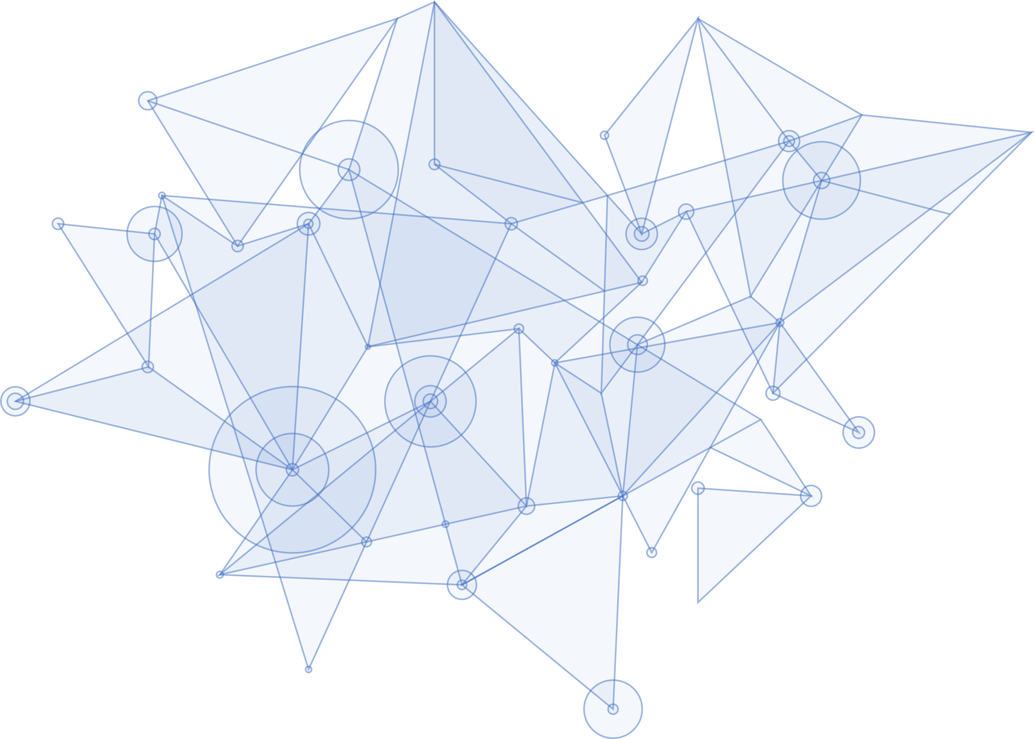


Activity 2: Design
Presenter: Francisco Aragó (UJI)
Agreements after Second Plenary Meeting
()
This project has received funding from the European Union’s Horizon 2020 research and innovation programme under grant agreement No. //////////////
project-seal.eu

Slide 2

Contents
01
Final Design
Current agreements on the design of the SEAL service
02
Functional Modules
Agreed specific modules to be implemented
03
User Interface
Current status of the design of the UI
04
Open Issues
Things left to discuss

Slide 3
Final Design
01

Slide 4
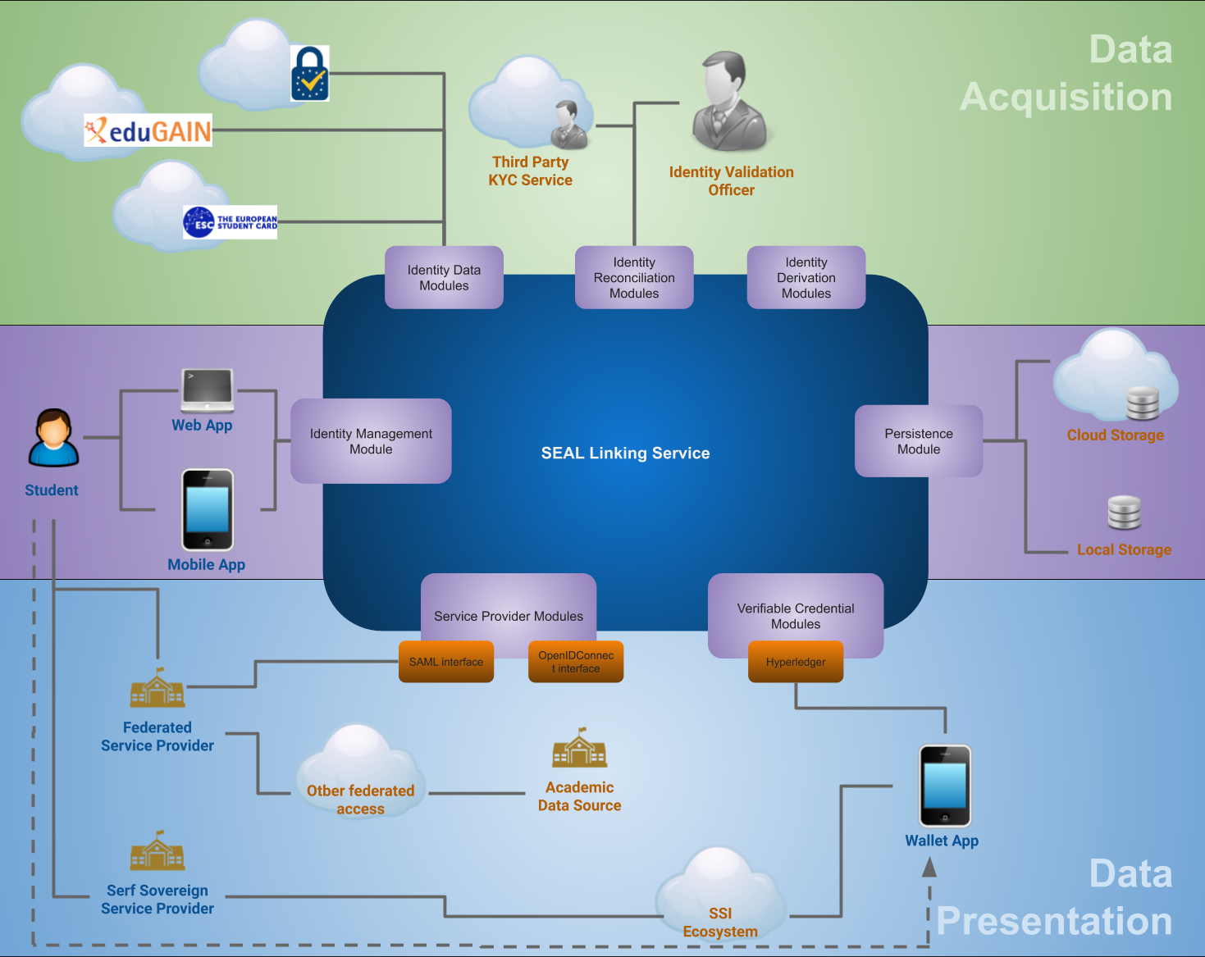
High-level Topology

Slide 5
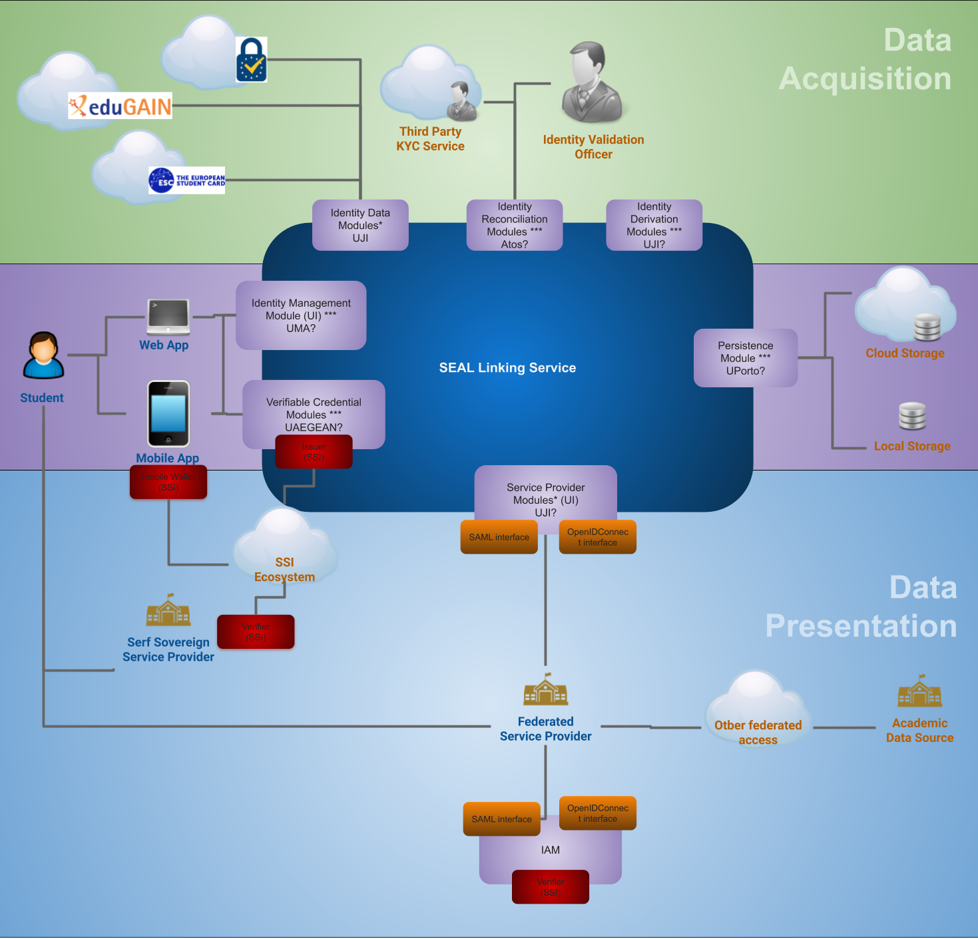
High-level Topology (alternative version)

Slide 6
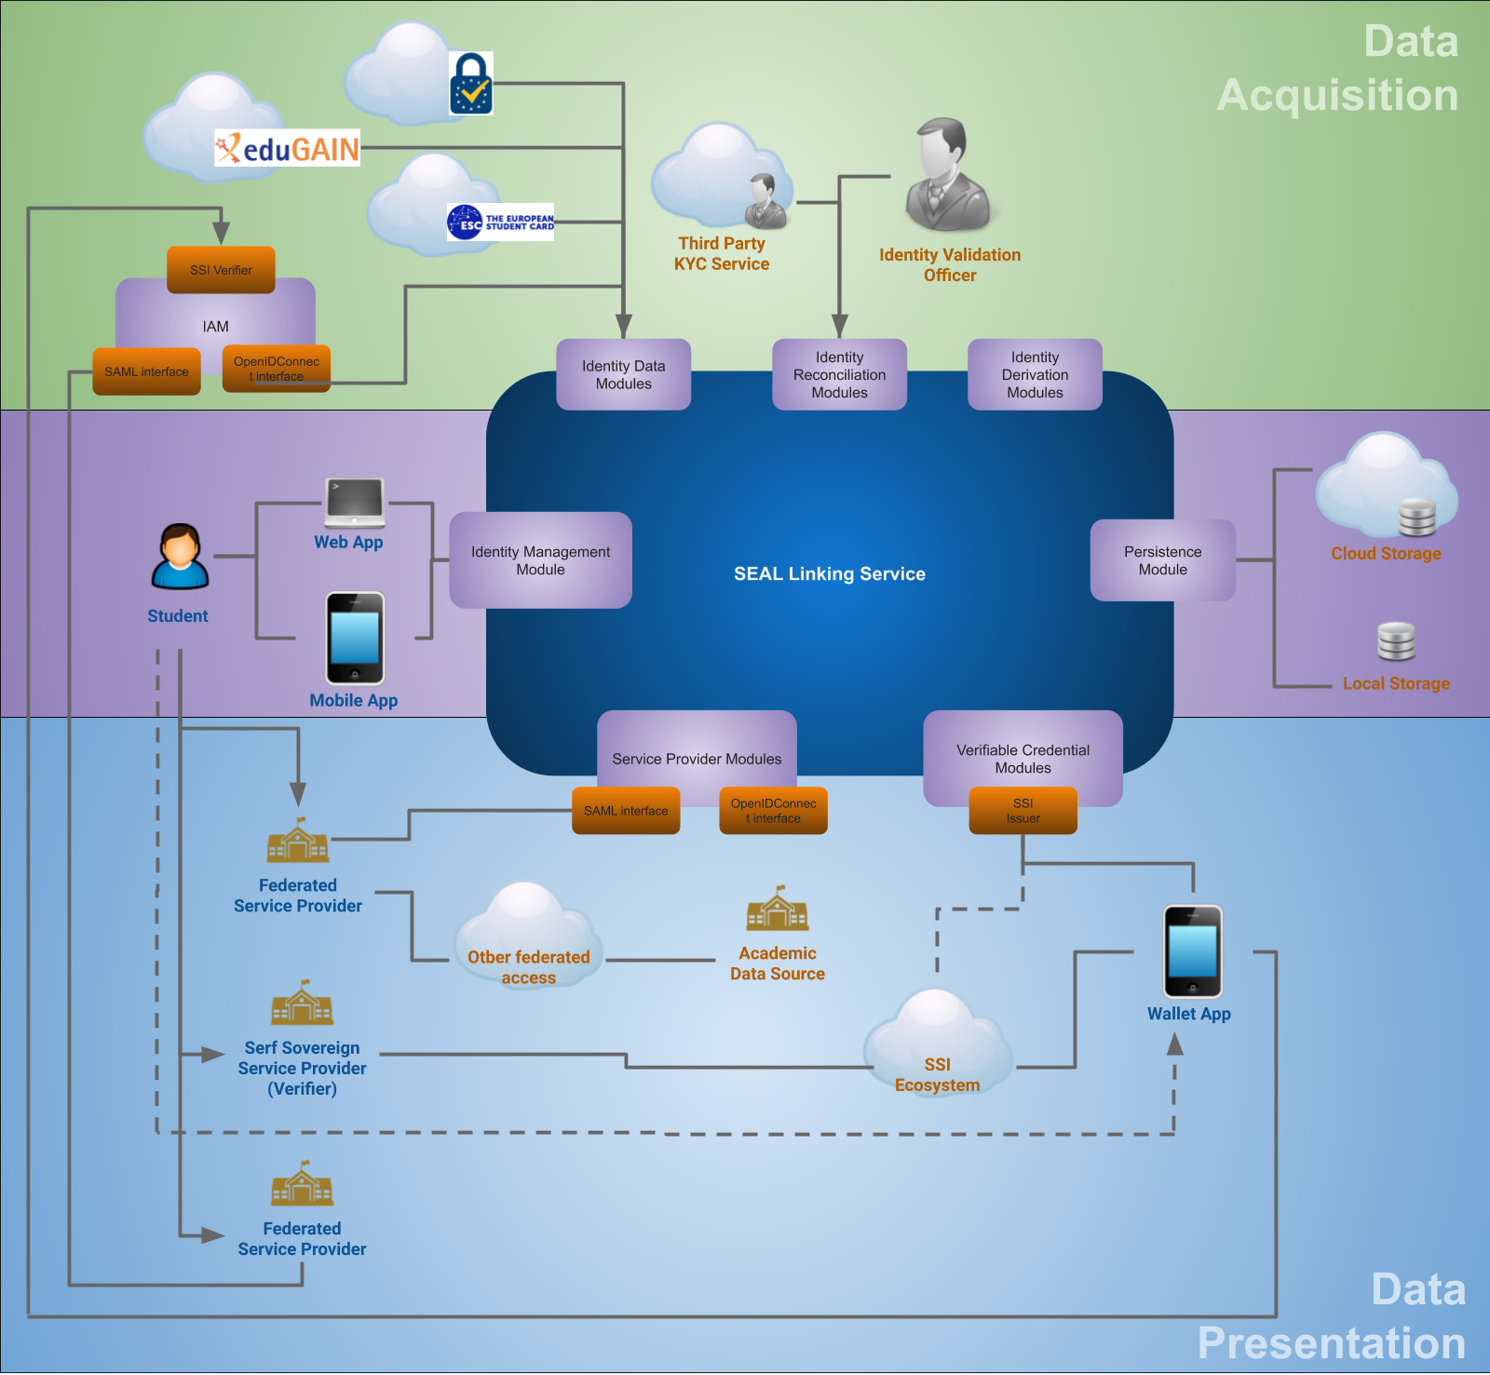
High-level Topology (After day 1 discussion)

Slide 7

High-level Topology (2019-11-29)

Slide 8
Characteristics
User data is stored on user-space storage
Data is stored only when (and if) user commands to
Usability settings can be stored on server-space
No storage of personal data, not even on reconciliation modules
Future action: ciphered sessions (on the fly at the SM, with volatile key)
A user can access different instances of SEAL carrying his own data with him
Different instances can have different functional modules connected (identities, identity linking procedures, etc.)
Most of the functionality will be server-side
web and mobile interfaces common and minimal logic (web subset of mobile)

Slide 9
Use Cases
UC1 - Accesses SEAL Service
User chooses authentication method and authenticates
Preferred auth method stored on user settings (cookie)
Authenticated identity dataset is added to the session identity storage
We no longer accept anonymous access on the mobile app, authentication is skipped. Can be required later for operations that require it (like derivation)
User is asked to do a DID authentication (if he owns a wallet) and/or to load a persistence storage (if any)
If there is a preferred persistence storage, user is asked to grant access to it
We can decide to [togglable through app property], on first access, prompt the user to configure a persistence method.
Preferred option is stored and highlighted in future access
If selected, DID auth is performed
If selected, Persistence storage is loaded into session
If successful, user gets access to the Dashboard, the hub for the user activity
If no DID auth, VC generation option won’t be accessible (with a note to let the user know what to do)
If no persistence storage is configured later or changes are not saved, data on session will be lost on exit

Slide 10
Use Cases
UC2 - User configures a persistence storage
Access Dashboard and choose Persistence config option or hit the save button
A discovery service will list all the available storage options
User chooses a method and control is passed to the specific module
The module will set up a secure persistence storage
User settings can be set by the module to facilitate persistence storage access on future accesses

Slide 11
Use Cases
UC3 - User adds an identity to his account
Access Dashboard and choose Identity option
A discovery service will list all the available identities to query
User chooses an identity and control is passed to the specific module
Generally server-side module, but mobile app could have some local module
The module will authenticate the user and obtain a trusted data set
The data set is stored on session by the module
If the user wasn’t authenticated, this will be set as the authenticated identity
The user will have to push save for it to write on persistence storage, if configured
If user pushes save and storage not configured, prompt to configure

Slide 12
Use Cases
UC4 - User wants to move data to another persistent storage
Access Dashboard and choose Persistence option (while there is another one already configured)
A discovery service will list all the available storage options
User chooses a method and control is passed to the specific module
The module will set up a secure persistence storage
All claims are copied to the new location
The user is prompted to choose whether to keep the current or set the new persistence module as active
If new is chosen, the new location is set as the new persistence module
Settings are updated

Slide 13
Use Cases
UC5 - User wants to generate a verifiable claim
Access Dashboard and choose Verifiable claim option
Selector of verifiable claim models is shown
If environment allows for unbound claim content, a data selection screen could be shown to select the data to include
Selector of possible destinations is shown
Module takes control and builds the selected model, with the expected/selected content, and issues it for the selected destination (module will have its own ‘recipe’ to build defined VCs).
Needed data sets will be first searched on the session data store (they can be there from loading a persistence datastore, or from live sources queried just before choosing to generate the VC). If not in session the module will trigger the access to the needed live sources.

Slide 14
Use Cases
User wants to revoke, amend or refresh a verifiable claim
This management is specific to the chosen SSI environment
For SEAL to be able to handle revocation of emitted VCs:
By the user:
Each VC module would implement a revocation interface
User would need to have a register of all the emitted VCs and a UI for the user to choose
Revoke datasets:
User would need a register of which datasets have been emitted into which VCs)
By third parties:
The validation officers should have a UI to revoke emitted claims
Validation modules supporting revocation WOULD NEED to store some VC registry, with info to know what to revoke.
SEAL would need an automated agent to receive revocation reqs by validators and forward them to claim modules (and the register of dataset-to-claim should be in SEAL, not in user space)
Revocation of datasets: Same as above, but every time the user connects, SEAL checks the blacklist and removes any revoked dataset.

Slide 15
Use Cases
UC6 - User wants to spawn a derivative identifier
Access Dashboard and choose Derived Identity option
A discovery service will list all the available derivation methods
User chooses a method and control is passed to the specific module
If the user is not authenticated with a live source, authentication use case is prompted this option is not available and user is requested to authenticate first
The module will generate the new identity
Methods can possibly generate auth credentials (i.e. password, software certificate, etc.), in which case, they will be stored on the proper IdP.
Identifier is stored on the session
Credentials, if any, are shown/returned to the user.
High LoA linking info is automatically generated and stored on persistence
Relating the authenticated identity and the derived identity

Slide 16
Use Cases
UC7 - User wants to raise the trust level of a link between two identities
Access Dashboard and choose Identity Reconciliation option
Selects the linking method from the list of available methods
Selector is shown to choose two data sets from session identity storage to relate
If the user is not authenticated with a live source, authentication use case is prompted this option is not available and user is requested to authenticate first
Control is passed to the selected module
Might require additional information to the user
Might include deferred validation by another person
Data must be stored on the server (temporarily to reduce exposition) there will be a shared session for the user and the validating officer, but the request is handled live, so if someone disconnects it gets lost.
Data Protection notice and user agreement mandatory
When done, all the process information is signed and moved to the user persistence
Might include writing transaction validation info on a validation service, for traceability.

Slide 17
Use Cases
UC 8 - Service Provider wants to (authenticate and/or) query linking information
SP delegates on SEAL
Through one of the multiple interfaces/protocols
SP can prefix many parts of the behavior:
If auth is wanted or only data query
If only live sources need to be queried or the persistence storage must be loaded
All interactions are skipped and a specific target is accessed
User is prompted to choose a source of info (SP can also prefix them):
From a connected persistence storage
Will request authentication on SEAL
Will load the default persistence storage (or prompt to configure one) ask to load a persistence storage
Will show selector of identity data to choose what to return
From an identity module
Will show selector of identity sources to choose which one to access
If the SP asks to, both cases above can happen sequentially, to enrich a live authentication assertion with linking data
SP receives a security assertion with the selected data
SEAL is the trusted issuer of the assertion

Slide 18
Use Cases
UC9 - User presents a verifiable claim to a SP
SEAL will not be involved in this use case (the SP validates the claim itself)
User accesses an SP and presents a VC from his wallet
SP cryptographically validates the VC and the ownership
If successful, grants access to user

Slide 19
Data Model
Object representing an imported dataset
Data set unique identifier
Subject Id attribute: name of the attribute that is the ID of the user, a kind of pointer to the attribute ID.
Issuer Id attribute: name of the attribute that is the ID of the entity tht issued the data set, a kind of pointer to the property ID.
LoA: Level of assurance of the authenticity of the data/authentication
Issue date: date when the data set was retrieved from its source
Expiration date: date when the data set becomes invalid
Attributes: [array] of pairs (key, object) representing data belonging to the subject
Properties: [array] of pairs (key, object) representing additional data (metadata) related to the subject or its data attributes

Slide 20
Data Model
Object representing an link between datasets
Unique identifier: of the link set
Link Issuer: Unique identifier of the issuer of the set
Subject A ID: attribute name in list which is the unique identifier in domain A
Subject A Issuer: identifier of the entity that issued subject A (the collision domain of the ID)
Subject B ID: attribute name in list which is the unique identifier in domain B
Subject B Issuer: identifier of the entity that issued subject B (the collision domain of the ID)
Issue date: date when the link was certified (the date this data set was issued)
Link LoA: level of certainty that both subjects are the same person
Attributes (String, Object)
Properties (String, Object)

Slide 21
Functional Modules
02

Slide 22
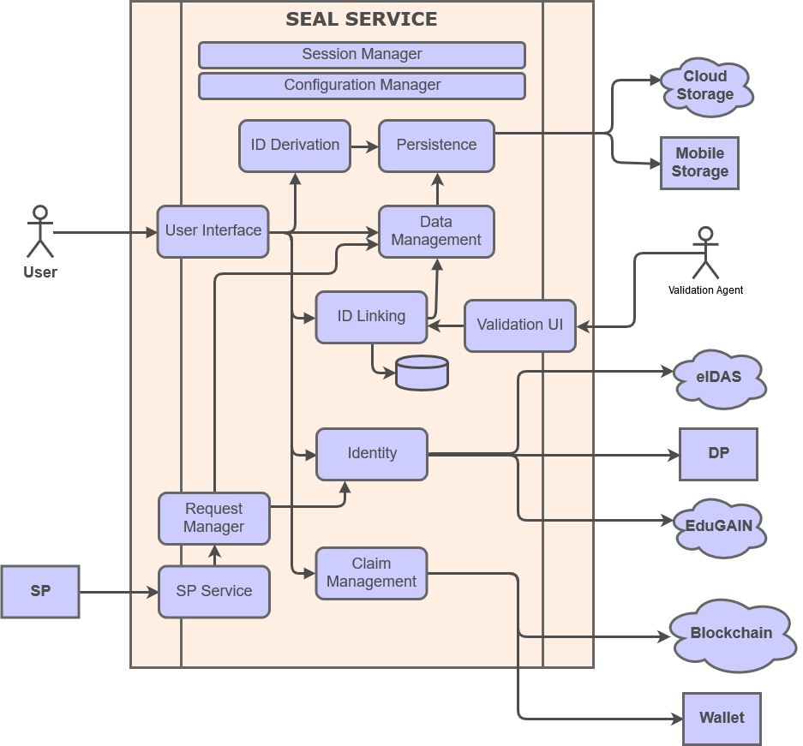
Modular Design

Slide 23
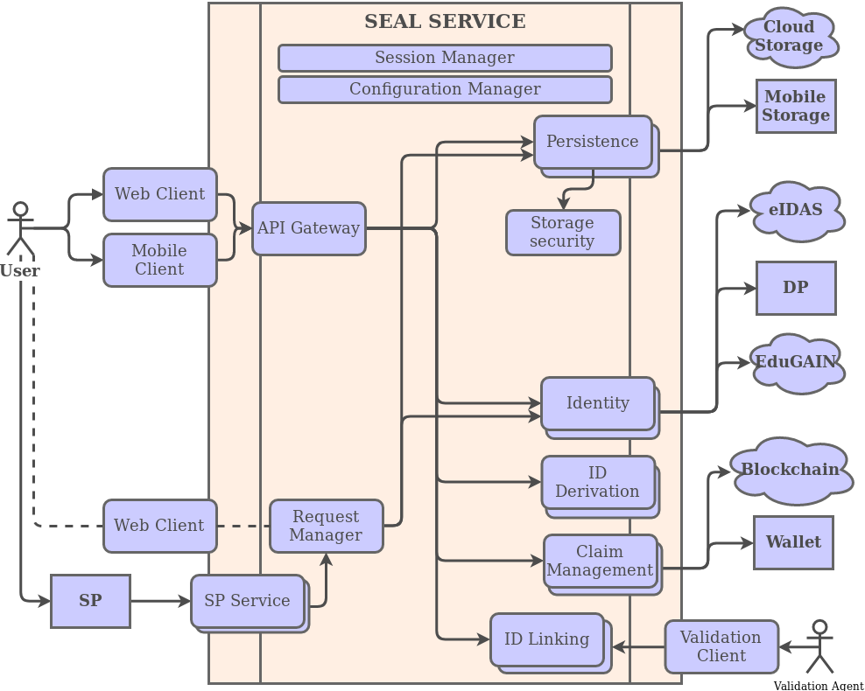
Modular Design: updated

Slide 24
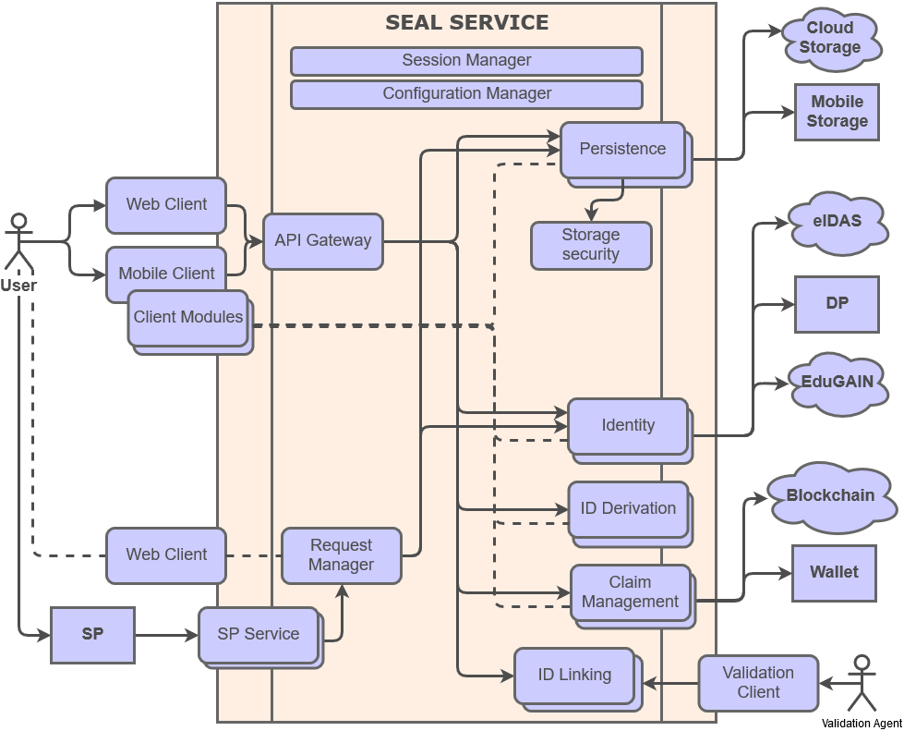
Modular Design: updated v2

Slide 25
General Modules
Session Manager
To keep the user operation state between microservice calls. Designed as the session layer of any application framework.
Configuration Manager
Module to keep a central repository of configuration, both private and public configuration.
Request Manager
Module to generically handle SP requests and show the selectors.
Data Management
Module to allow selection/deletion/refresh of existing identity data sets

Slide 26
Persistence Modules
Common module
Receives the identity store data structure
Generates a blob containing the encrypted signed data structure
AES256-GCM encryption with user password
RSA signature with SEAL private key
Can decipher and validate blob to produce an identity store data structure
Local storage save module
Calls the common module to produce a blob
Prompts the user to download/upload the blob as a binary file with the browser

Slide 27
Persistence Modules
Local storage mobile module
Calls the common module to produce a blob
Will use the permissioned API of the mobile to write/read the blob to a local file
Local storage browser module
Calls the common module to produce a blob
Will use the browser local storage API to write/read the blob in B64
Google Drive storage module
Calls the common module to produce a blob
Will use the google drive API to write/read the blob in a file on the user’s account

Slide 28
Identity Linking Modules
Automated – Remote
String similarity algorithm comparison of a set of attributes with transliteration, on a fixed threshold
Two data sets are loaded from trusted sources (i.e. EduGAIN and eIDAS)
Both sets are compared based on an attribute mapping
Assurance level: low-medium
Depending on the attribute set and on the threshold
Convenience: medium-high
High chance of false negative/false positive depending on the threshold
Effort is minimal for all involved stakeholders

Slide 29
Identity Linking Modules
Semi-automated – Remote
String similarity assessment + human agent validation
Same as the previous one, but the threshold is just a supporting item for the human in charge of validation (an official in HEI B).
Assurance level: medium-high
Depending on the attribute set including biometrics
Convenience: medium
Low chance of false negative/false positive (only human error, but multiple validation could be added)
Required effort is bigger, and depends on requests number

Slide 30
Identity Linking Modules
Manual – In-person
Human agent validation
User starts a request remotely both for HEI A and HEI B, but must go to HEI A and HEI B for ID validation by an officer.
Includes in-person validation of officially issued ID documents.
Upload copies of proofs of identity for cross-validation at both HEIs
A validating party will analyse the request and the provided proof to determine that it was the same individual who attended both
Assurance level: high
Convenience: low
Required effort and infrastructure is elevated, although existing front-desk facilities can be leveraged

Slide 31
Identity Linking Modules
Online Officer Validation Module Internals
Demonstration, not intended for out of the box production usage
No persistent storage of user data
Validations are done online, in one or many sessions
When an officer connects, he creates a session
When a user does a request, if there is a fitting officer session open and free, they are bound and do the exchange
For added security, the officer can create a volatile asymmetric key on the client to encrypt the shared session objects
When the session ends (either it is finished or more data is to be provided in a future session), the session data is stored back on the user space (encrypted and signed).

Slide 32
Authentication Modules
eIDAS
Acts as a SP for eIDAS. Might require MS specific implementation.
eduGAIN
Acts as a SP. SAML2Int

Slide 33
Identity Modules
eIDAS
Acts as a SP for eIDAS. Might require MS specific implementation.
eduGAIN
Acts as a SP. SAML2Int
European Student Card (?)
Would require a back-channel connection with ESC-server, or read from the UMA app.
MyAcademicID is planning tom deliver it through eduGAIN. Maybe wait?

Slide 34
Identity Modules
Social Network Identities (?)
Low level IDs. Easy to implement. Mostly OAUTH
Maybe as a low priority module?
Machine-readable Travel Documents (?)
Read from specific mobile apps connected to the SEAL mobile app
OrcID (?)
Acts as a OAUTH relaying party. Weak authentication. Public API might not return all attributes.
Leave as low-priority

Slide 35
Identity Derivation Modules
Random UUID v4
Generates a random unique identifier and associates it to the authenticated identity

Slide 36
Service Interface Modules
SAML2-eIDAS
Accepts eIDAS-compliant SAML2 authn requests and issues equivalent responses
SAML2Int
Accepts EduGAIN-compliant SAML2 authn requests and issues equivalent responses
OpenID Connect
Accepts OIDC requests and issues equivalent responses

Slide 37
User Interface Modules
User web app/mobile app
Implements user controls and holds the main application logic, calling the rest of the modules
Validator web app
Implements user controls and holds the application logic of the identity validator officers

Slide 38
SSI Modules
Verifiable Claims Management
?

Slide 39
Module Interfaces
Module Interfaces to be specified (OpenAPI?)
Session Manager (session, token)
Configuration Manager (public, protected)
Discovery
Data Manager
Identity
Authentication
Persistence
Linking (request, listing, validation, chat)
Service (response)
Request Manager (request)
Verifiable Claim
Bootstrapping

Slide 40
User Interface
03

Slide 41
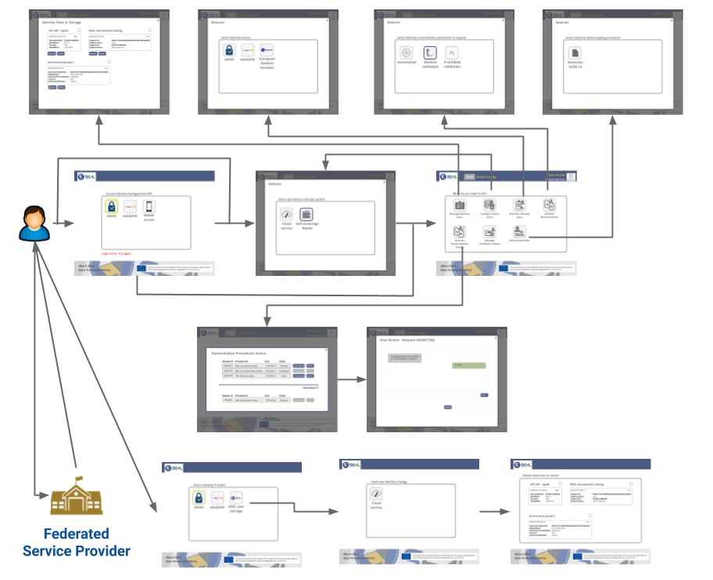
Web Application Flow

Slide 42
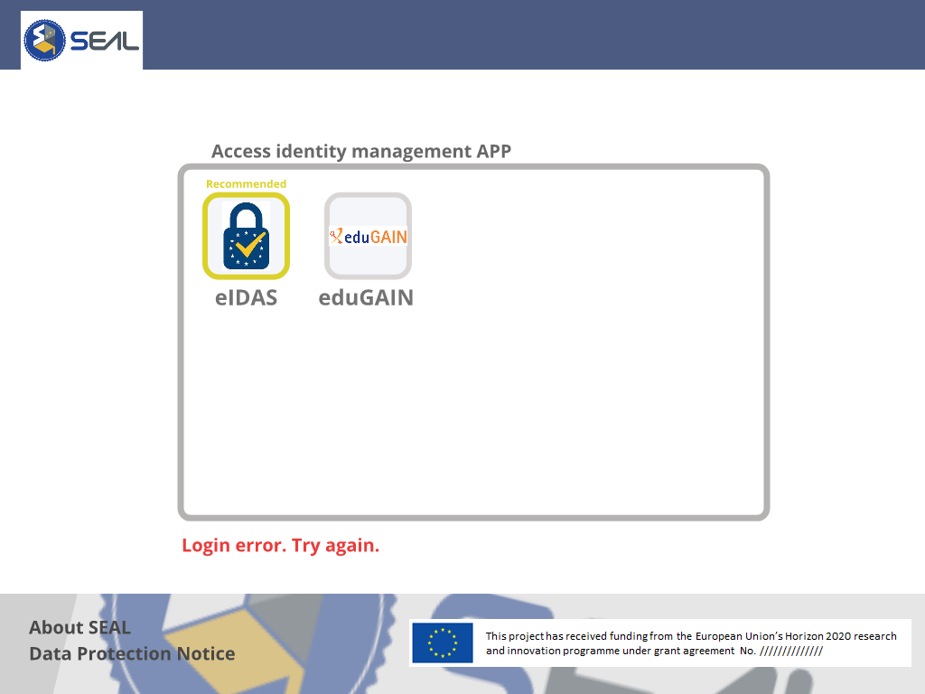
Web Application: login

Slide 43
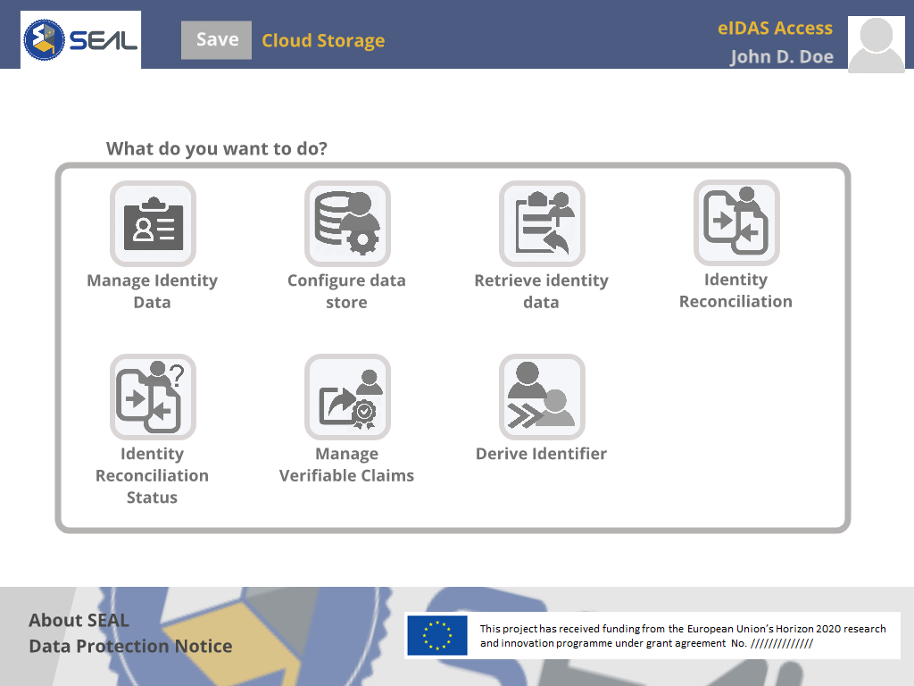
Web Application: Dashboard

Slide 44
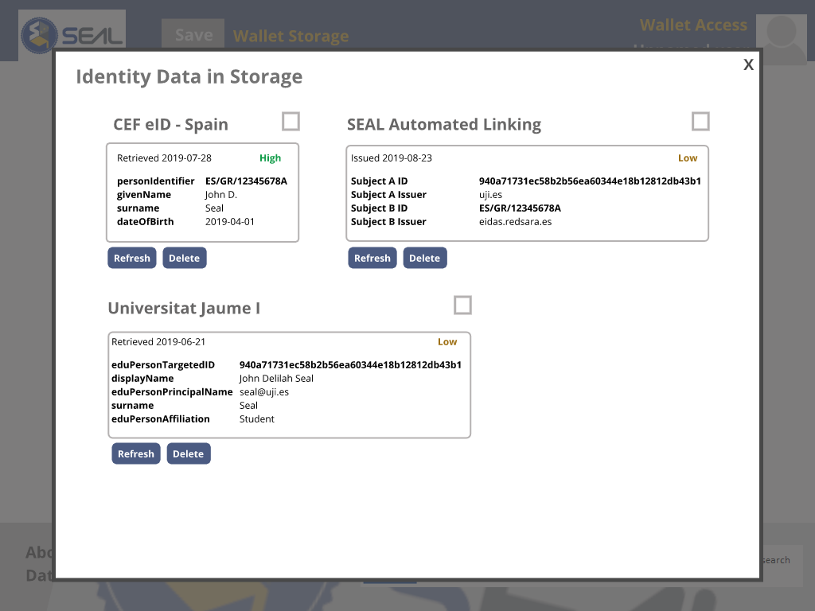
Web Application: Data Selector (V1)

Slide 45
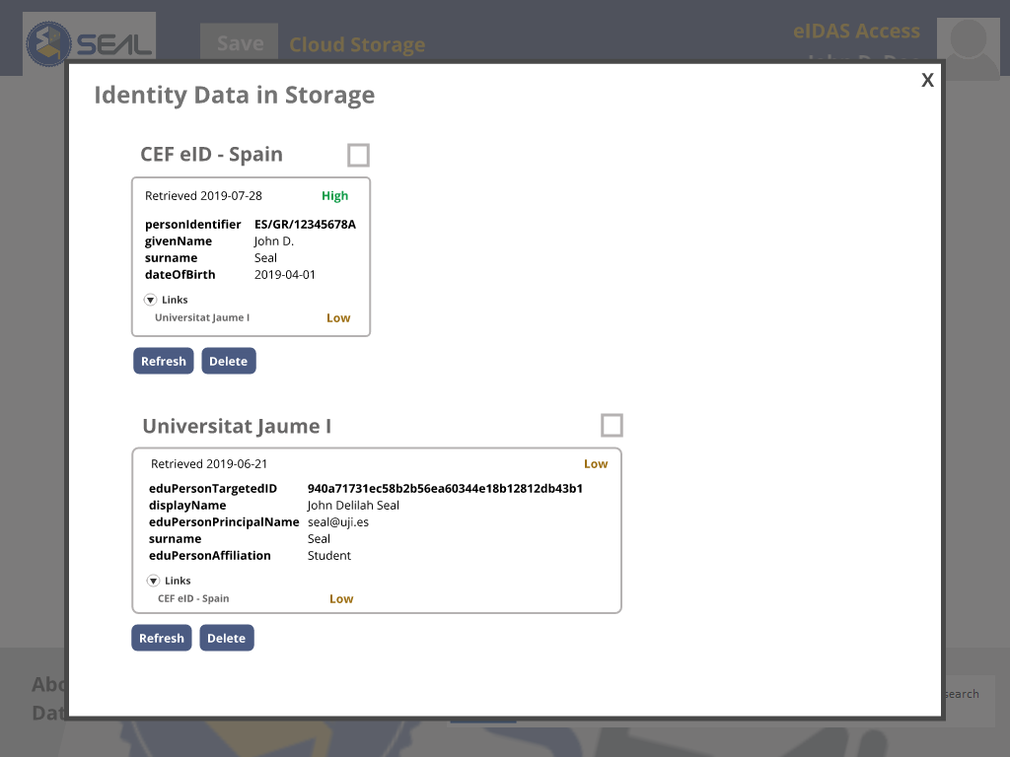
Web Application: Data Selector (V2)

Slide 46
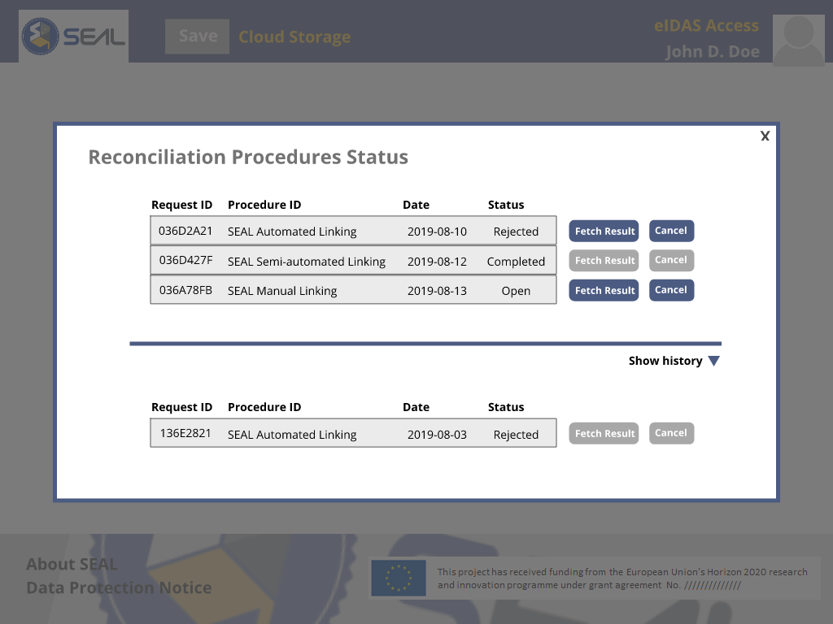
Web Application: Reconciliation Status

Slide 47
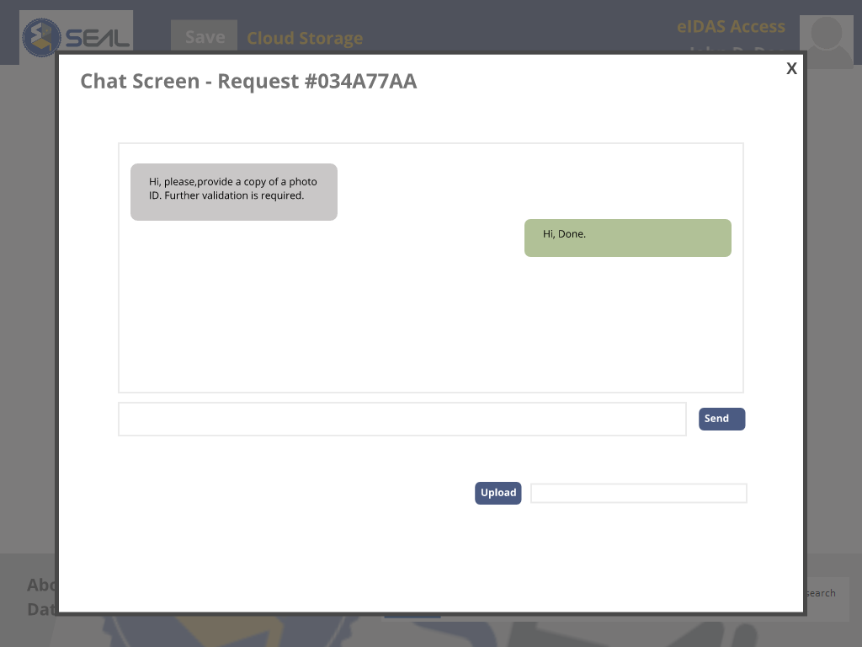
Web Application: Reconciliation Status Chat

Slide 48
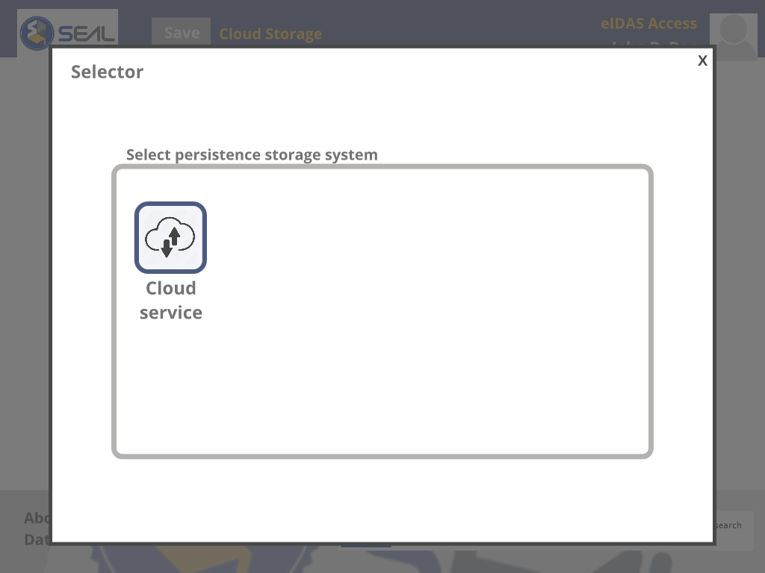
Web Application: Persistence Method Selector

Slide 49
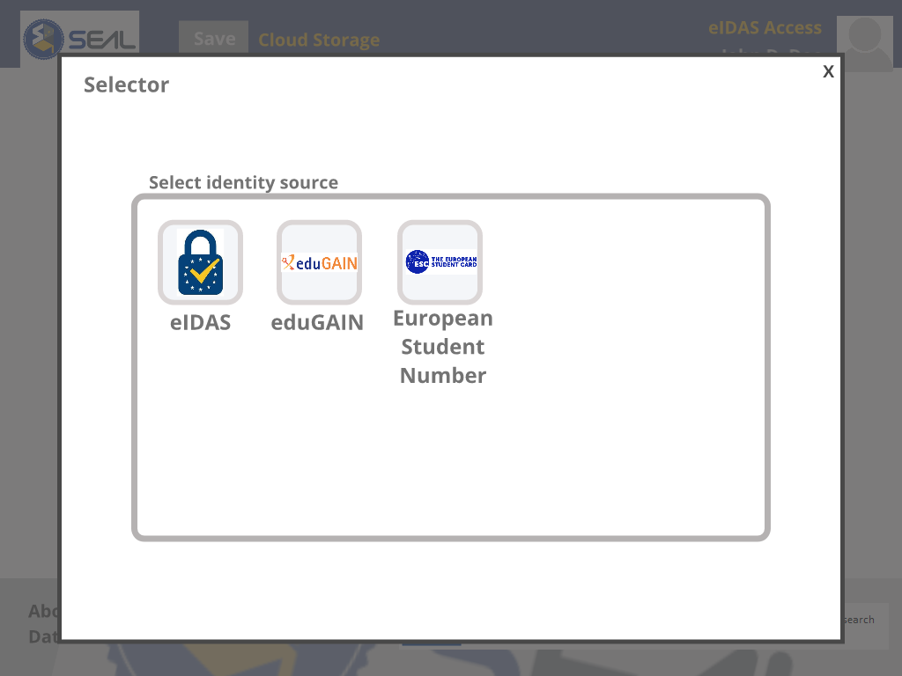
Web Application : Identity Source Selector

Slide 50
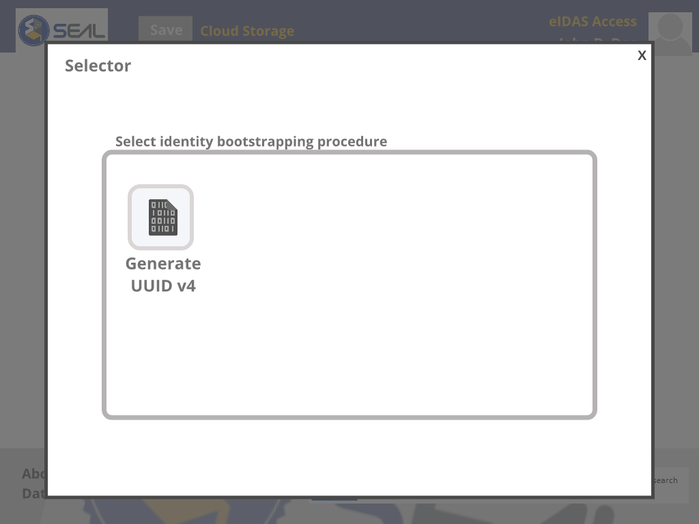
Web Application : Derivation Selector

Slide 51
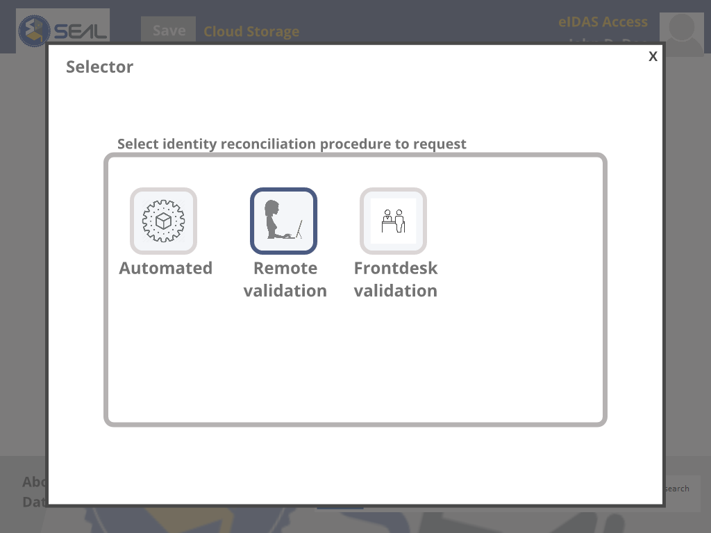
Web Application: Reconciliation Selector

Slide 52
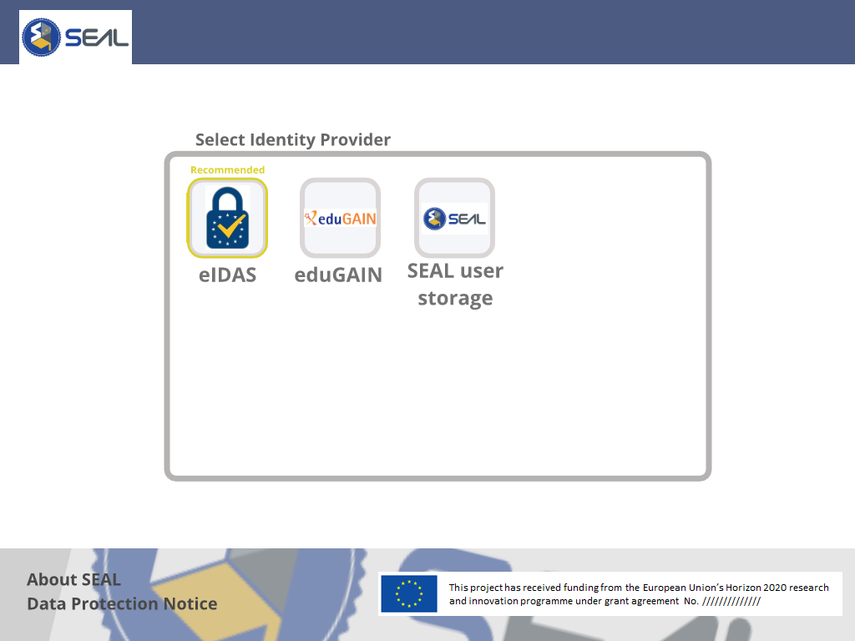
SP Federation Web Application: Source Selector

Slide 53
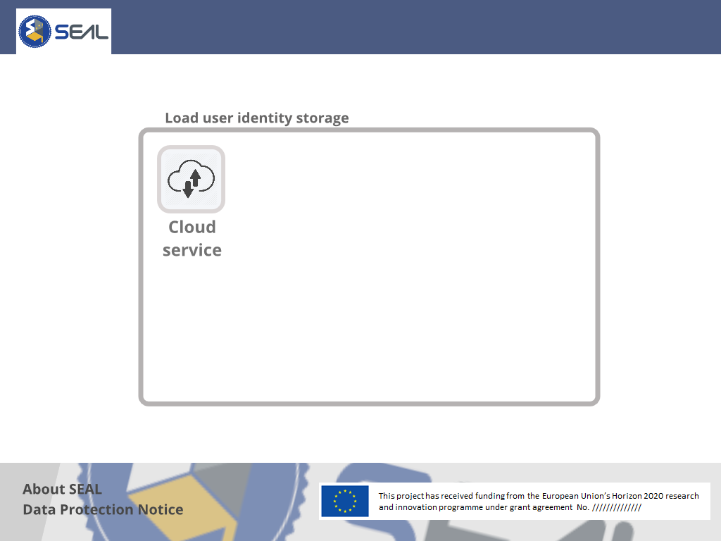
SP Federation Web Application: Persistence Selector

Slide 54
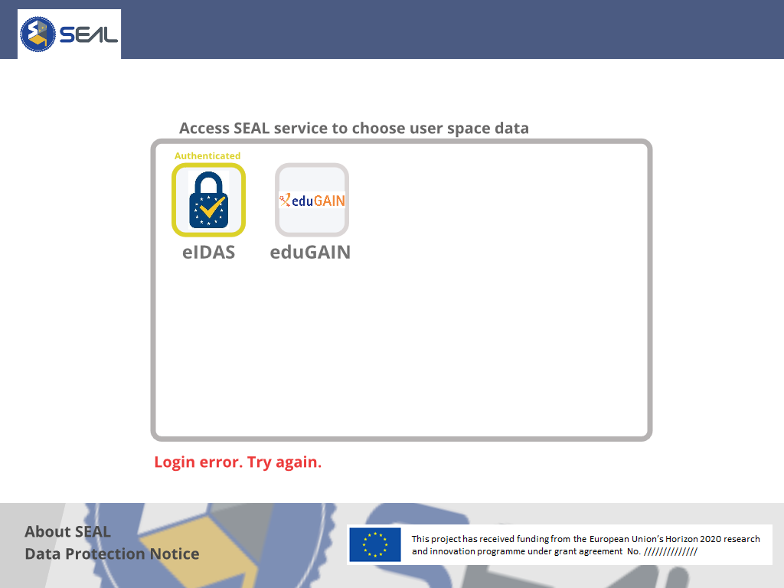
SP Federation Web Application: Auth - DEPRECATED

Slide 55
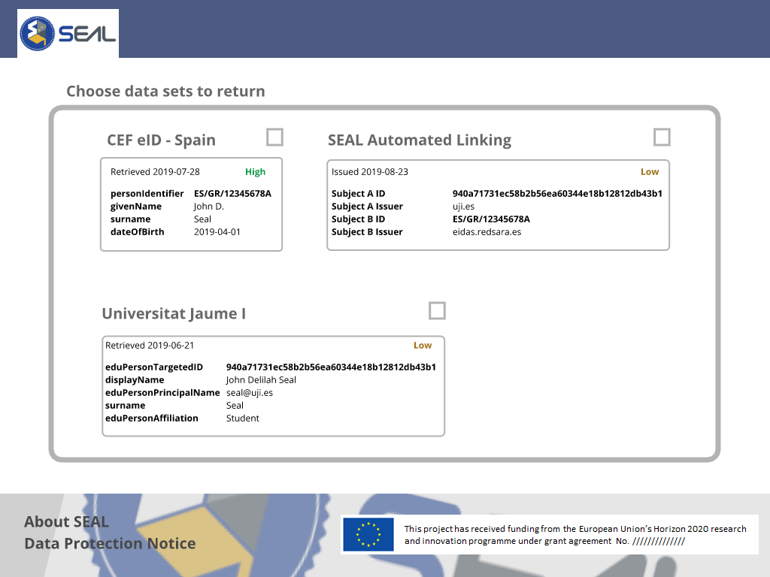
SP Federation Web Application: Data Selector (V1)

Slide 56
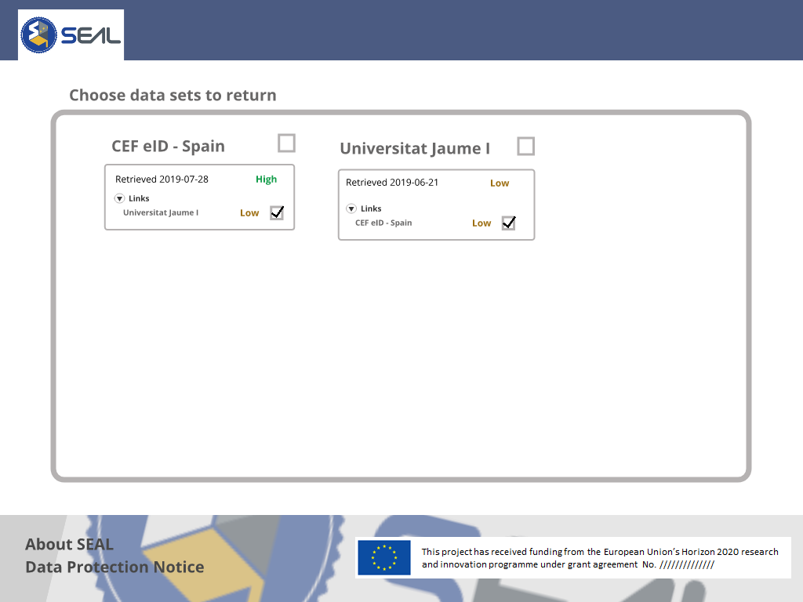
SP Federation Web Application: Data Selector (V2)

Slide 57
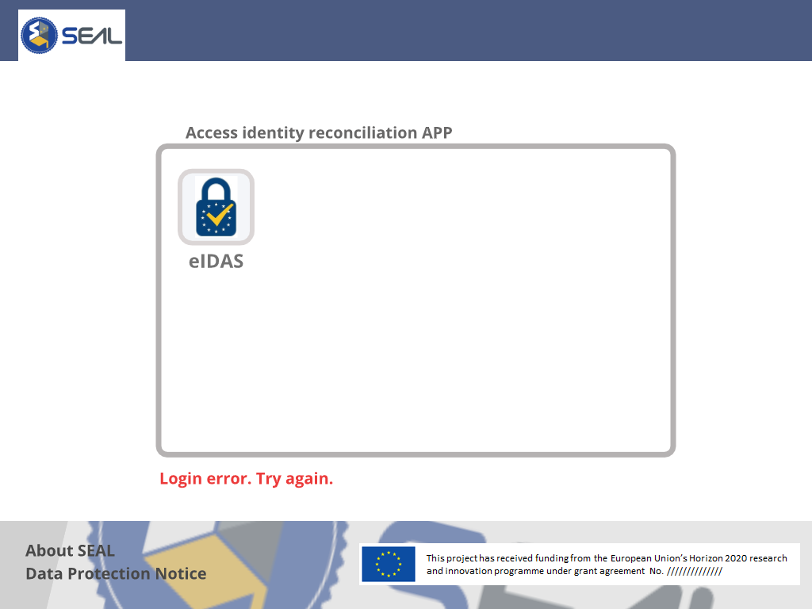
Validator Web Application: Login

Slide 58
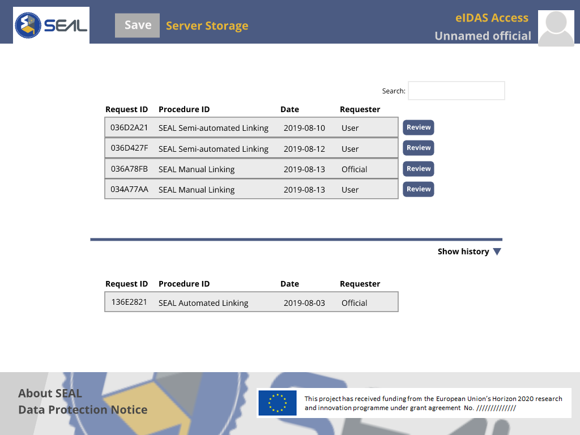
Validator Web Application: Main

Slide 59
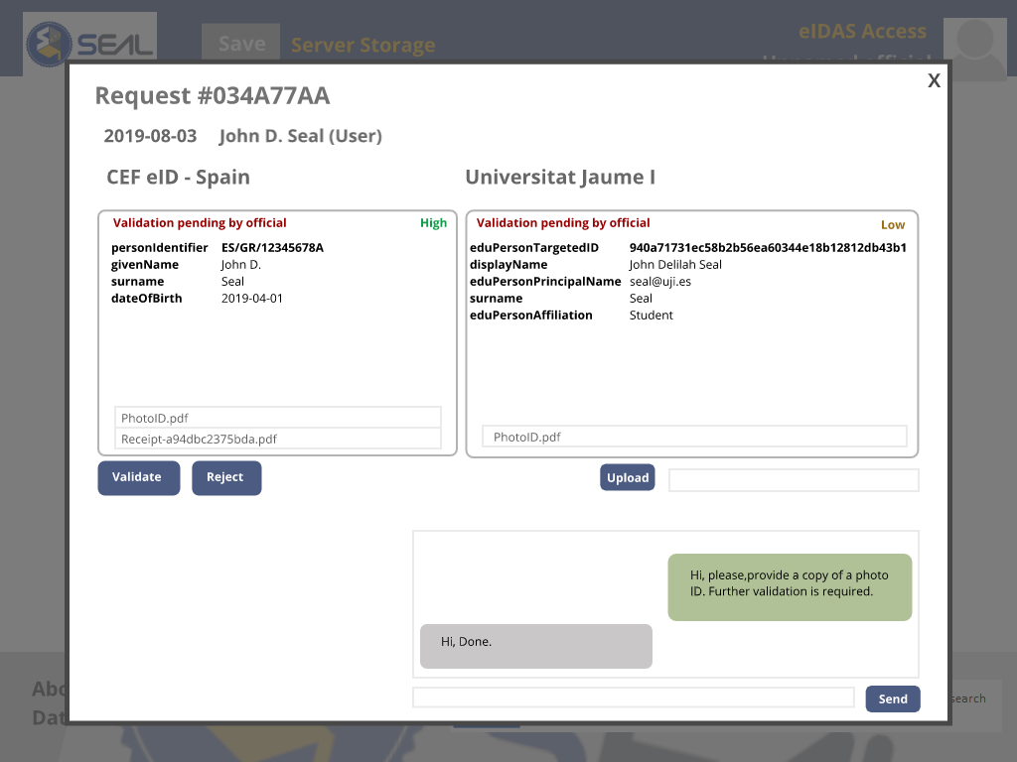
Validator Web Application: Request Screen

Slide 60
Web Application Issues
Open Issues
Decide on selector to use.
V2? toggle? v2 for selection, v1 for editing?
Are there any differences between webapp and mobile app?
VC UI design:
selector of datasets + selector of VC formats + wallet destinations?

Slide 61
Open Issues
04

Slide 62
Open Issues
Identity Link Level of Assurance (LLoA)
As a platform for linking, SEAL issues “certificates” on the level of assurance of two datasets belonging to the same individual.
SEAL does not decide on the LoA of the imported Datasets, only the LLoA of the links between them
The LLoA depends on:
Quality of the datasets matching
Quality of the datasets verification towards a real person
Quality of the sources of both datasets
Only link pairs of datasets
Transitive property between Links, applying minimum common LLoA

Slide 63
Open Issues
Linking LoA Schema
0 - User claim or remote automated validation with low similarity threshold
1 – remote automated validation with high similarity threshold
2 - remote human validation of documentation that is unlikely to be forged/stolen by an impersonator (procedure can include uploading a copy of the ID/driver's license, utility or bank bills, etc.)
3 - in person human validation of unfamiliar (officer is not especially trained to, like university personnel) officially issued ID card or passport with photograph. Average level of cross-trust between officers in different validation offices.
4 - in person human validation of familiar (officer is trained to) officially issued ID card with photograph (reserved for an official MS deployment of SEAL). High level of cross-trust between officers in different validation offices
5 - in-person biometric validation under human supervision on a controlled environment (we don't support this)

Slide 64
Open Issues
SSI interface Issues
Uport decision:
Architecture details
Components,
What we need to implement or integrate
VC formats
Fixed or open?
On the BC or not?
How to issue them? Requirements
How to connect web/mobile app with wallet app?

Slide 65
Open Issues
Identities Issues
Do we implement ESC module over UMA app or do we skip it based on myAcademicID future plans?.
Security Issues
Firebase Cloud Messaging vs QR Code

Slide 66








THANK YOU
for your attention
farago@uji.es
http://project-seal.eu/
This project has received funding from the European Union’s Horizon 2020 research and innovation programme under grant agreement No. 837854
www.seal.org

Slide 67
T3.4 Service interfaces implementation
Protocols supported for authentication and query will be the same as ESMO:
saml2Int
saml2eIDAS
OIDC
Reuse ESMO microservices
We need to design a URI format to deliver the linking info as a simple attribute on SAML and OIDC interfaces

